Slide 1


Anomaly Detection using Unsupervised Learning
Research Project Presentation(I)
Shantanu Dave(11130387)
Masters in Communication Systems and Networks (MaCSN)
Mentored by: Prof. Dr. -Ing. Markus Stockmann
Institut für Automatisierungstechnik

Slide 2
Outline
What are Anomalies?
Why to detect Anomalies in process industry?
Task Description
Outlook and timeline
Appendix

Slide 3
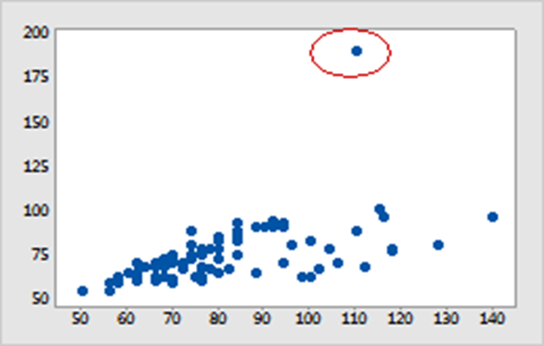
What are „Anomalies“?
Anomaly is a pattern in the data that does not follow the expected behaviour
It is also referred to as „Outliers“, „Exceptional cases“ etc
Anomaly Detection plays a vital role in
a) Electronic sensor events
b) Intrusion Detection system
c) Fraud Detection
d) Process Chemistry
Image Source: Identifying outliers - Minitab

Slide 4

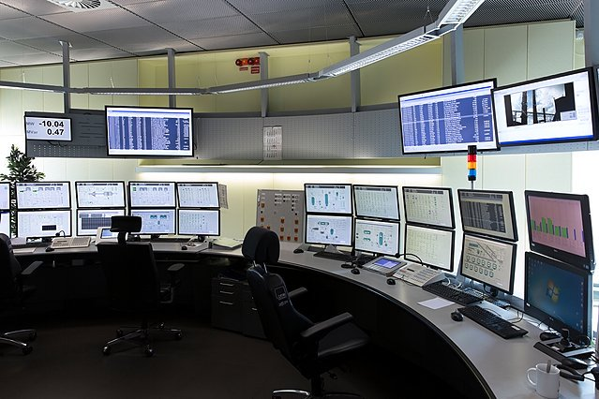






Why to detect „Anomalies“ in process industry
Anomaly detection is part of a bigger project to detect unsafe situations in process chemistry

Slide 5

Task Description – Development of Intelligence
What are the „brain“ tasks
Fetch data from an Access point (last sensor bot),
2. Impute missing data, eliminate outliers and non compliant data
(e.g. due to sensor mistakes),
3. Perform the Unsupervised learning and inform the user
(e.g. by setting some bit from 0 to 1) in case of any abnormality.

Slide 6
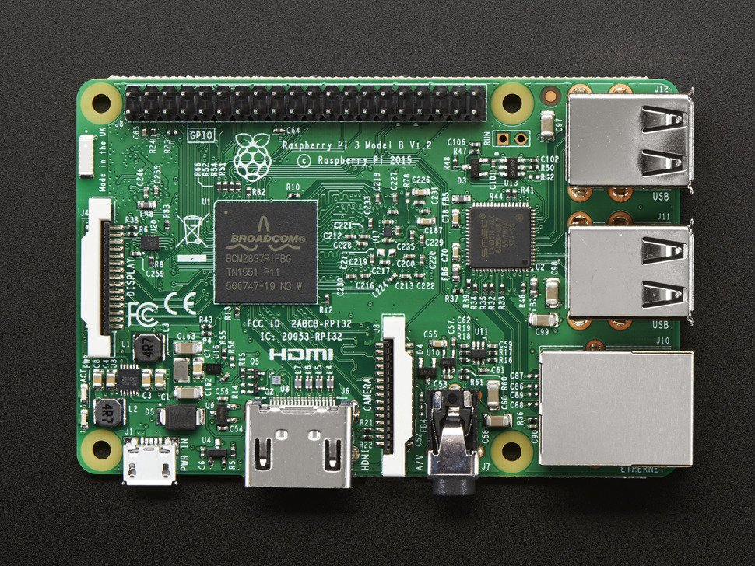

Task Description – What are the requirements
06/11/2019
Solution: Raspberry Pi 3B+
Requirements:
High computing power
Possibility to use „AI“ and „Machine Learning“ Packages
WLAN connectivity to connect to AP
Digital outputs
Possibility for GUI
[1]
Processor: 1.2 GHz Quadcore Broadcom 64bit CPU
RAM: 1 GB
GPIOs: 40 pin
Ethernet Port: Yes
HDMI: full size HDMI
Storage: Micro SD
Wi-Fi: BCM43438 wireless LAN

Slide 7
Task Description - Relevance of the topic
Significance : Very important topic for process industry
Is there anything comparable?
Advantages:
Detect unsafe situations as early as possible
This is a robust and safe way to realize the anomaly detection

Slide 8

Task Description – 1. Fetching data
Web Scraping is the process of downloading data from websites and extracting valuable information from that data.
There are several ways, but the Beautiful Soup module along with Requests in python is widely used measure.
Running the code on Raspberry pi w/
scheduling(time function or crontab)
Reasons for opting Python
Simple and consistent
Extensive selection of libraries and frameworks
Platform independence
Great community and popularity
[2]

Slide 9
Task Description – 2. Data pretreatment
It is a technique that transforms the raw data into an understandable format as the data received from real-world is usually incomplete (presence of missing values) , inconsistent(out of range data) or is likely to contain errors(outliers).
Ways to handle Missing Data
Remove rows having missing data
Impute missing data
Using mean values
Using MICE(Multivariate Imputation by chained equation) values
Using k-NN

Slide 10
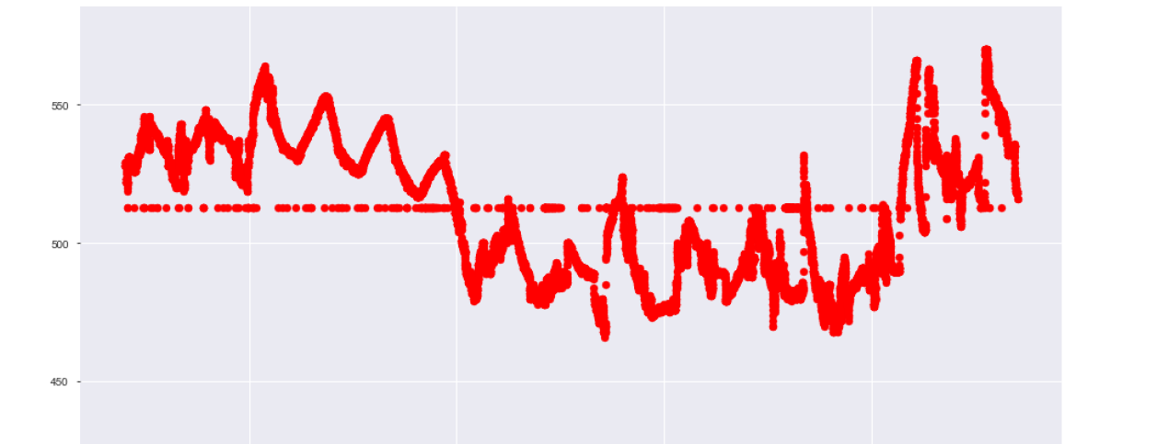
First results: Data Imputation Using Mean values
Task Description – 2. Data pretreatment
Signal Value
Sampling Time
This works by calculating the mean of the non-missing values in a column and replacing the missing values in each column by the calculated mean value.
Can handle numeric data types.

Slide 11
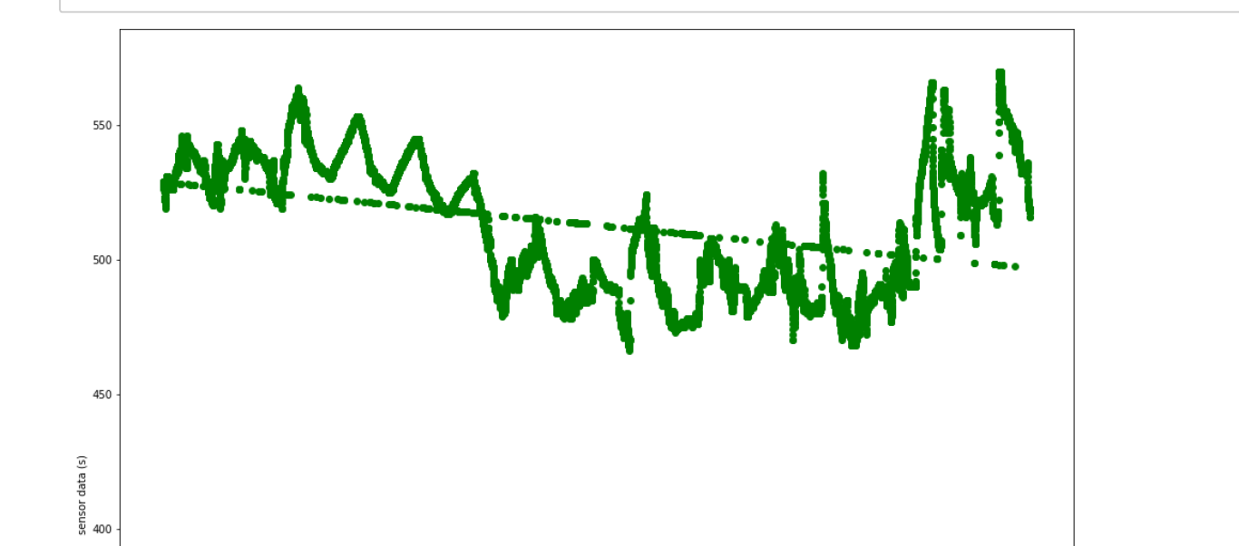
Task Description – 2. Data pretreatment
First results: Data Imputation Using MICE
Sensor Data
Sampling Time
This type of imputation works by filling the missing data multiple times, measuring the uncertainty of the missing values in a better way.
Can handle different variables of different data types.

Slide 12
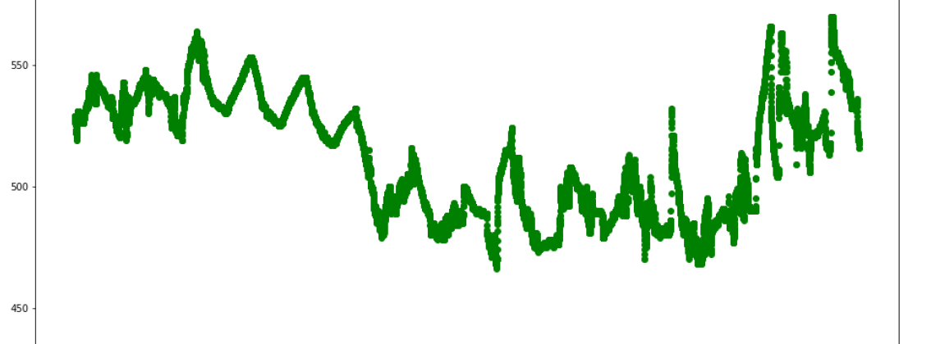
Task Description – 2. Data pretreatment
First results: Data Imputation Using k-NN
Sensor Value
Sampling time
k-NN is an algorithm that is useful for matching a point with its closest k neighbours in a multi-dimensional space.
Can be useful for dealing with all kinds of missing data

Slide 13
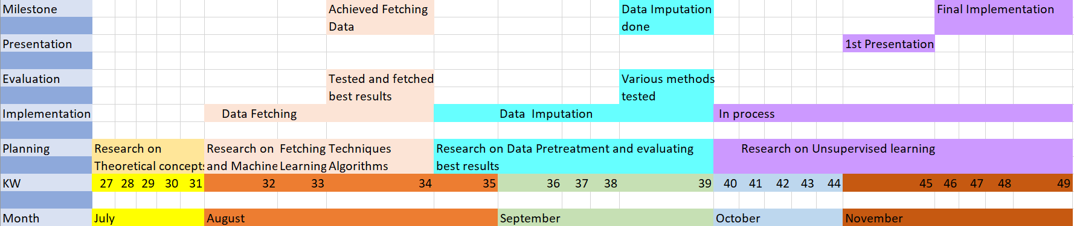
Outlook and Timeline

Slide 14
References
[1] https://www.adafruit.com/
[2] https://www.codeburst.io/
[3] Aggarwal, Charu C. "Outlier analysis." Data mining. Springer, Cham, 2015
[4] Munir, Mohsin, et al. "Deepant: A deep learning approach for unsupervised anomaly detection in time series." IEEE Access 7 (2018): 1991-2005.
[5] http://bit.do/fga4x
[6] http://tiny.cc/nuctfz

Slide 15
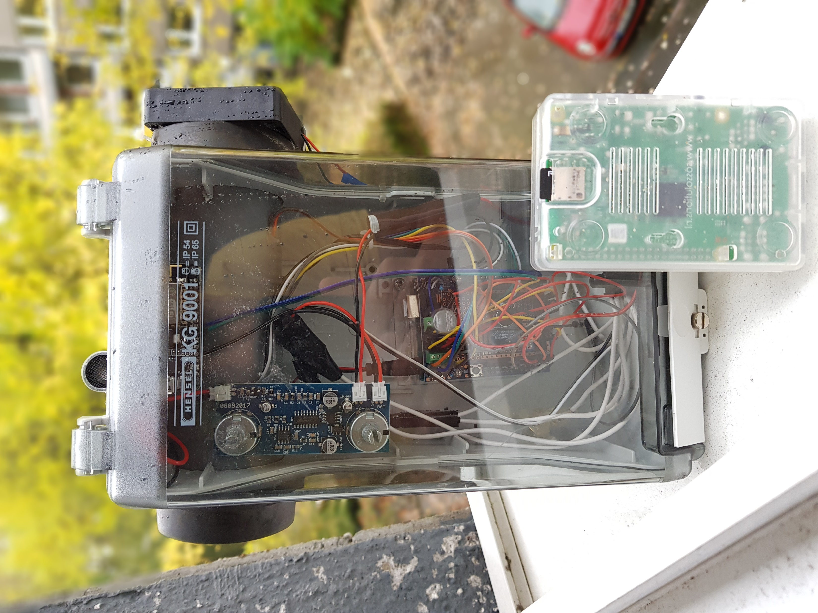
Appendix: Sensor Bot and Raspberry pi image
Image Source: Shantanu Dave

Slide 16
Appendix: How do the sensor bots work?
Measurement 1: Noise level (0 to 5V in 10bit resolution --> 0 to 1023)
Measurement 2: Light level (voltage divider, LDR type and resistor, 0 to 5V in 10 bit resolution)
Measurement (3,4,5): Gyroscope (x,y,z) direction (default setting is +/- 250 deg/sec)
Measurement 6: Temperature (voltage divider, thermistor and resistor : 10kO resistor and a 10kO thermistor (at room temp). This leads to a range of 400 to 600 (roughly).
Measurement 7: Dust measurement (0 to 8000 pcs/0.01cf )
Measurement 8: CO2 (400 to 8192 ppm)
Measurement 9: TVOC (organic) ( 0ppb to 1187ppb)
Measurement 10: Humidity (20 to 90% rel humidity)#
Last and the most important one is The ESP8266 ESP-01, it is a Wi-Fi module that allows microcontrollers access to a Wi-Fi network

Slide 17
Thank you!!!

Slide 18



